Slide 1
Introduction to Natural Language Processing (NLP)
Notes:
This course strives to teach you state-of-the-art machine learning techniques that are routinely used to make computers mimic some capabilities of the human brain such as image/sound perception, anomaly detection, clustering, pattern recognition and inference.

Slide 2
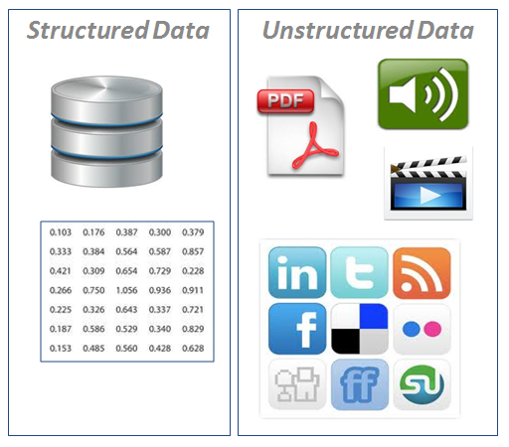
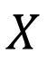
Recall that data can be partitioned into 2 big chunks
Data can be divided into 2 big types:
Structured data refers to information with a high degree of organization such as for instance a table in a relational database.
Structured data is easy to search
Easy to interpret for computers and humans
Unstructured data has none or loose internal structure. It is definitely not structured via pre-defined data models or schema.
Typical types of Unstructured data are text language data, audio, images and video files
Unstructured data is usually not easily searchable
Easy to interpret for humans but hard for computers
$$X$$

Slide 3
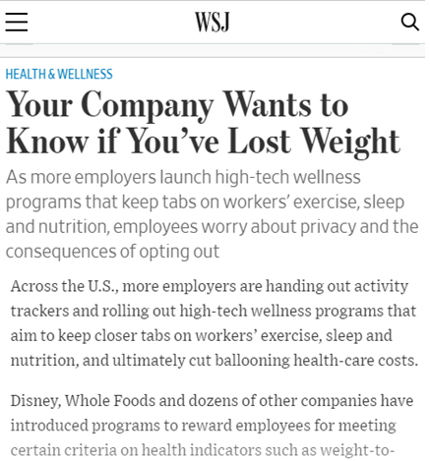
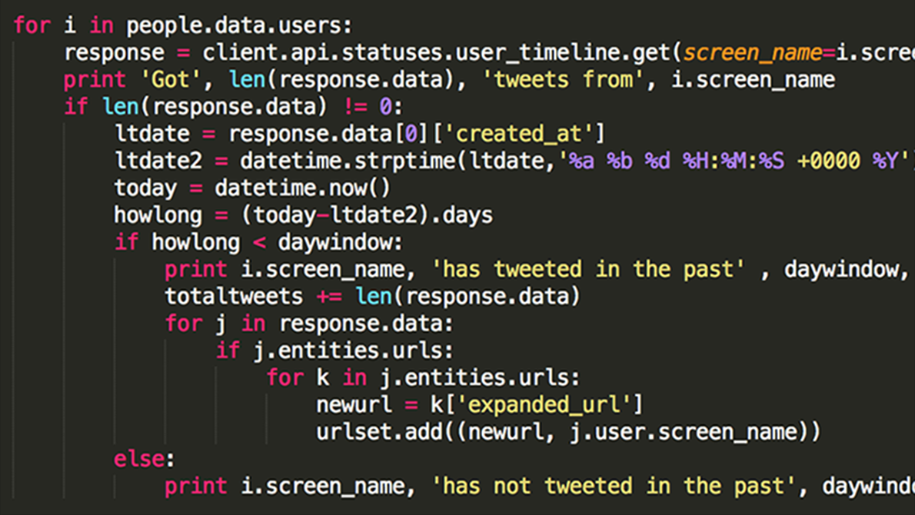
Natural language vs. artificial language
Natural language is defined as a language that has developed naturally in use (as contrasted with an artificial language or computer code.”

Slide 4
Natural language processing refers to the computational processing of unstructured language data
NLP is difficult because working with unstructured data is hard
Machine learning algorithms are pretty good at extracting information from structural data
Extracting information from unstructured data is much harder

Slide 5

The Dream
It’d be great if machines could
Process our email (usefully)
Translate languages accurately
Help us manage, summarize, and aggregate unstructured data (scientific papers)
Use speech as a UI (when needed)
But they can’t:
Language is complex, ambiguous, flexible, and subtle
Good solutions need linguistics and machine learning knowledge
NLP is the discipline that studies the tools that could make computers properly understand and use human language
Hey buddy, send new year postcards to all my friends in the address book… and ye… translate to German for my German friends
Done!

Slide 6
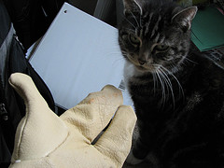
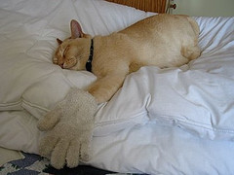
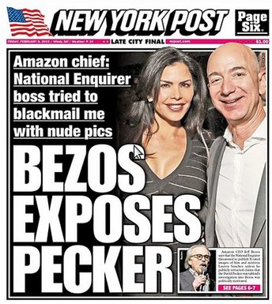
How is it that human language is hard to interpret for a computer?
How can a machine interpret this?
Get the cat with the gloves!
Newspapers headlines:
The Pope’s baby steps on gays
Boy paralyzed after tumor fights back to gain black belt
Juvenile court to try shooting defendant
Scientists study whales from space

Slide 7
Language is difficult to represent to a machine
Language is ambiguous
Subtleties
Cultural references
Contextual knowledge
Jokes, sarcasm, wordplay
Phonetic similarities between words
Grammatical rules can help somehow, but this only gets us half way
Human intuition: this guy is trying to build his relationship with the girl

Slide 8
Linguistic ambiguity
The trophy doesn’t fit into the brown suitcase because it’s too small
What is too small?
The suitcase or the trophy?
The trophy doesn’t fit into the brown suitcase because it’s too big
You can easily tell what “it” is, using your own understanding of trophies and suitcases.
A computer usually lacks that sort of “common sense”

Slide 9
If NLP is so difficult, why do we bother?
Because most of the data in the world is unstructured
Allowing machines to understand text unlocks vast amounts of knowledge

Slide 10
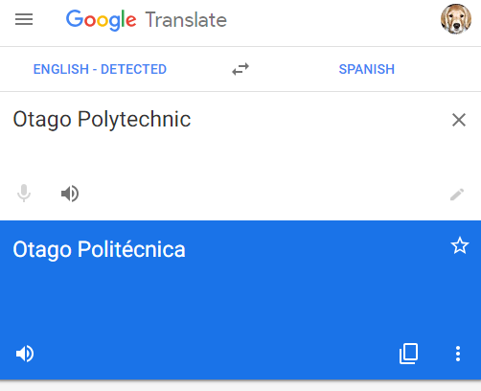
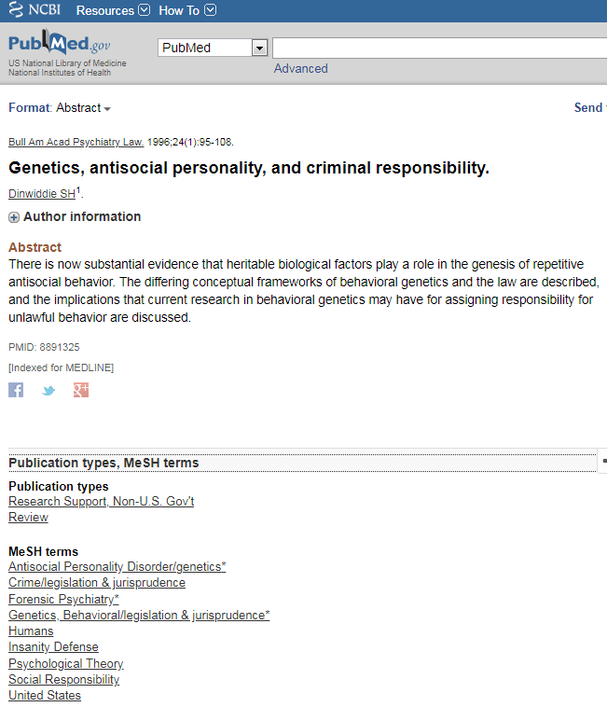

We use NLP technology everyday
Translation Engines
Recommendation systems
Document annotation
Spellcheck, autocomplete and search results

Slide 11
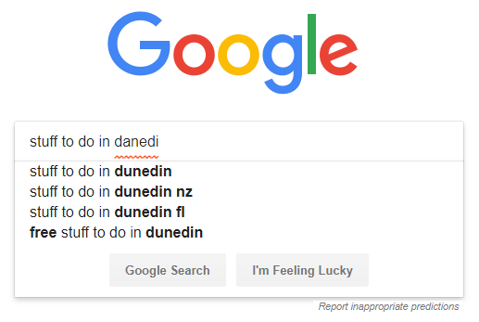
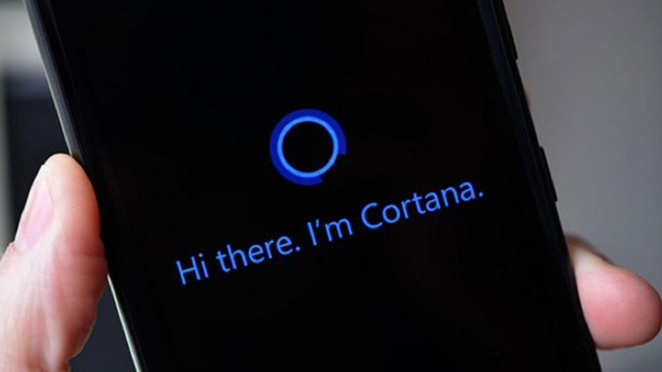
We use NLP technology everyday
Document annotation
Spellcheck, autocomplete and search results
Speech recognition

Slide 12

We might be using this technology in the not so distant future

Slide 13

Hype warning! Remember Google glasses in 2012?
Remember to take always with a grain of salt announcements from large corporations

Slide 14
NLP Applications
Text-to-Speech (speech synthesis)
Speech recognition
Natural Language Dialogue Interfaces to Databases
Who was the first Taiwanese president?
Information Retrieval/Extraction
Text Mining: Find everything that interacts with gene BRCA1
Document Classification
Text Categorization/Routing
Document/Image Analysis
Automatic text Summarization
Text Proofreading – Spelling & Grammar
Report generation by aggregating disconnected pieces of data
Autocompletion/Predictive Text
Machine Translation
Story understanding systems
Plagiarism detection
Social media analytics
Political opinion tracking
Product marketing
Sentiment analysis
Dialogue systems/chat bots

Slide 15
NLP progress over time
Where state-of-the-art technology is at present
Where we would like to be
find all web pages containing
the word Otago,
Spellcheckers, grammar checkers
read the last 3 months of Wall Street Journal and provide a summary of the presidential campaign so far
Hand-crafted Systems – Knowledge Engineering [1950s–1980s ]
Foundational work: automata, information theory, etc.
First speech systems
Machine translation (MT) hugely funded by military
Rules written by hand; adjusted by error analysis
Require experts who understand both the systems and domain
Iterative guess-test-tweak-repeat cycle
Optimism
Automatic, Trainable (Machine Learning) System [1990s– ]
The Empirical Revolution
The tasks are modeled in a statistical way
Data driven NLP
Corpus-based methods become central
Deep analysis often traded for robust and simple approximations
More robust techniques based on rich annotations
Expectations get reset
?

Slide 16
Levels of Language Analysis
Phonology: Convert Acoustic signals (phonems) to a textual transcript
Phonemes can be identified using their phonetic & spectral features
Morphology: Analyzes Structures and patterns in words from minimal units of meaning, or morphemes (suffixes, prefixes, stems, etc.)
Dogs= Dog+s
Buses = Bus + es
Carried = Carry + ed
Destruct + ion = Destruction (Noun)
Beauty + ful = Beautiful (Adjective)
Syntax: the grammatical structure of the sentence
Constituents, Grammatical relations, subcategorization and dependencies
Semantics: Converting the syntactic structures to semantic format
How to represent meaning? Semantic network? Logic? Policy?
Pragmatics: structures and patterns in discourses. What information is contained in the contextual sentences that is not conveyed in the actual sentence?
“What’s your name?”
“John, and yours?”
The second sentence is not complete, but what it means can be inferred from the first one
Discourse: structure of connected text, i.e. the nature of the discourse relationships between sentences. Recognizing and classifying the speech acts in a chunk of text:
yes-no question, content question, Statement, Assertion, Refutation, Elaboration, Explanation, Contrast, etc

Slide 17
The NLP Pipeline and terminology
Gather text
Data cleaning
Represent text as data
Modeling Phase
Validation Phase
What makes NLP different from the other algorithms we have a study so far is how difficult and computationally intensive this steps can be

Slide 18
Gather text
Data cleaning
Represent text as data
Modeling Phase
Validation Phase
The goal of data cleaning is to standardize the text as much as possible, so that words with the same intent are grouped together
Forms of data cleaning are:
Stemming/Lemmatization
Stopwords filtering
Remove special characters, remove repetitive spaces, lowercase,…

Slide 19
Gather text
Data cleaning
Represent text as data
Modeling Phase
Validation Phase
Stemming: reducing words into their base root/stem form
E.g. exploring→explore

Slide 20
Gather text
Data cleaning
Represent text as data
Modeling Phase
Validation Phase
Lemmatization: is similar to stemming, but uses morphological analysis of words to return them to the root

Slide 21
Gather text
Data cleaning
Represent text as data
Modeling Phase
Validation Phase
Removing “stop words”: removes common words that don’t add meaning

Slide 22
Gather text
Data cleaning
Represent text as data
Modeling Phase
Validation Phase
Lowercase, remove multi spaces, remove special characters (#$%&!...)

Slide 23
Gather text
Data cleaning
Represent text as data
Modeling Phase
Validation Phase
Once we have cleaned the text, we can represent text as data using a process called tokenization
Tokenizing means breaking up the text into words, phrases, or arbitrary elements (aka tokens)

Slide 24
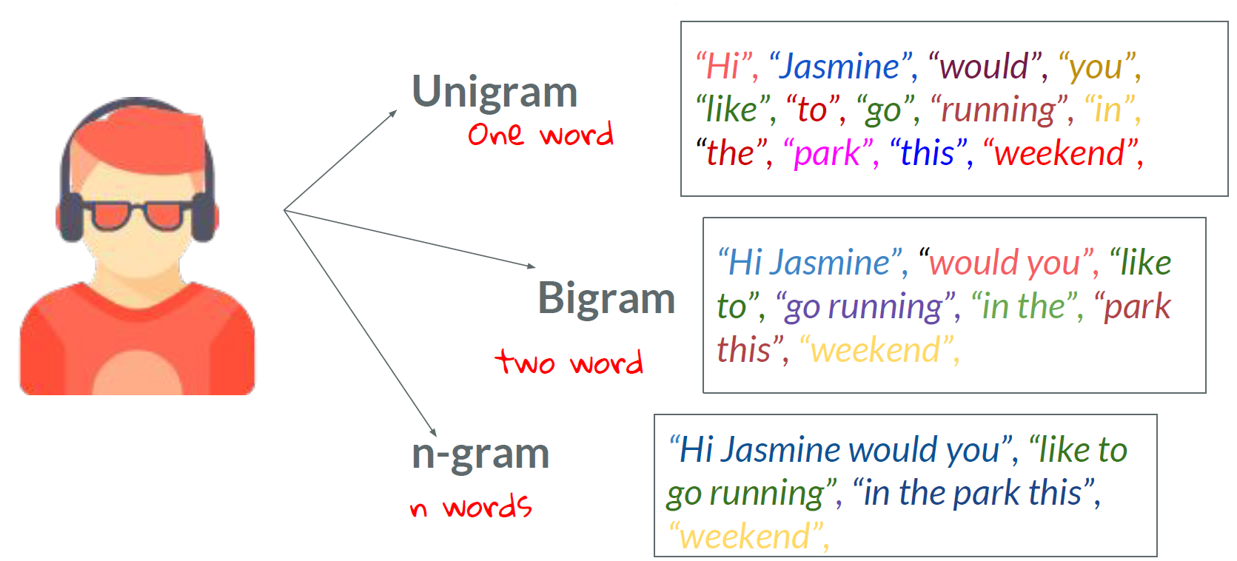
Gather text
Data cleaning
Represent text as data
Modeling Phase
Validation Phase
You can tokenize to unigrams, bigrams, trigrams, n-grams…
Is there a best type of tokenization?
Unigram models ignore context of a word, so bias is high
Bigrams, Trigrams models take into account context, but need more data to train

Slide 25

Gather text
Data cleaning
Represent text as data
Modeling Phase
Validation Phase
Bag of words is a representation of text that uses unigram tokenization
It is computationally simple but it does not take words context into account
With a bag of words representation a document that reads “it’s bad, not good” would have the same representation as a document that reads “it’s good, not bad”
Good
It’s
bad
not

Slide 26
Gather text
Data cleaning
Represent text as data
Modeling Phase
Validation Phase
In a bag of words representation, the words can be represented in a few different ways
Binary counts
Frequency table
TF-IDF

Slide 27
Binary counts
Binary indicators are 1 or 0 depending on whether the word is present in the document

Slide 28
Frequency counts
Frequency counts are the number of times each word appears in the document
Frequency tells us how important a word is to a document
But how can we judge how important is that word in the entire corpus ( all documents)?

Slide 29
TF-IDF: term frequency, inverse document frequency
TF-IDF is a number assigned to each word, intended to reflect how important that word is to a document
TF-IDF increases proportionally to the number of times the word appears in the document, but is offset by the frequency of the wod in the corpus
TF-IDF can tell us which words provide the most information about a given document
Relying on the frequency table alone, we might have missed the relative importance of the word “running”

Slide 30
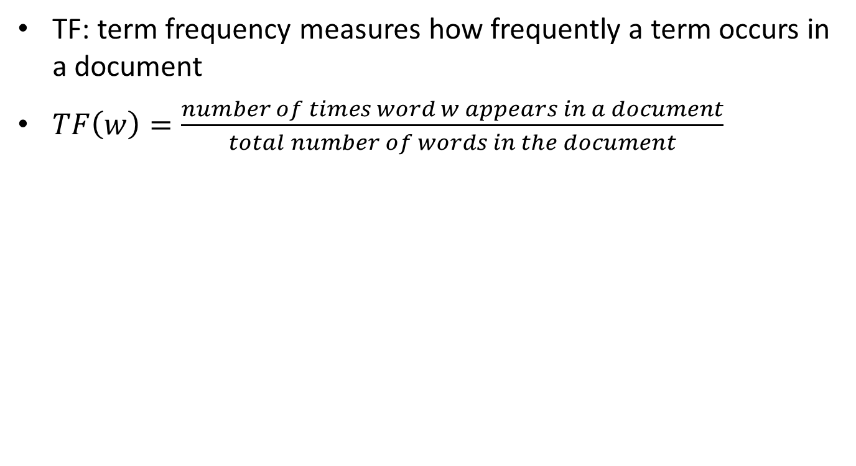
Term frequency
TF: term frequency measures how frequently a term occurs in a document
$TF\left(w\right)=\frac{number of times word w appears in a document}{total number of words in the document}$

Slide 31
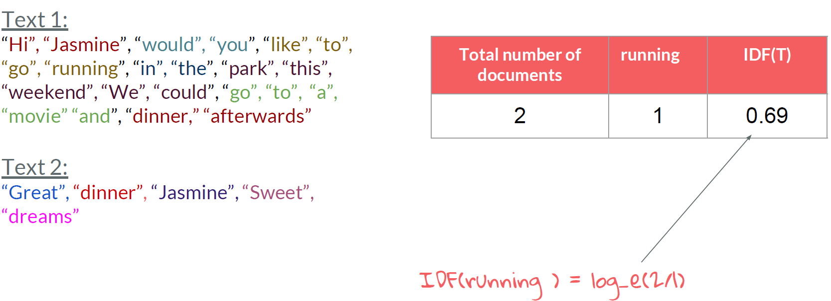
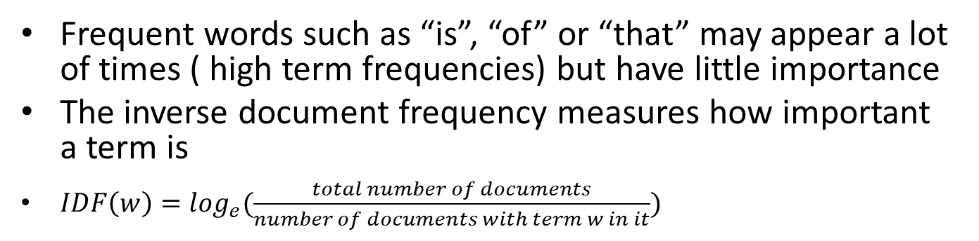
Inverse document frequency
Frequent words such as “is”, “of” or “that” may appear a lot of times ( high term frequencies) but have little importance
The inverse document frequency measures how important a term is
$IDF\left(w\right)=\log_{e}(\frac{total number of documents}{number of documents with term w in it})$

Slide 32
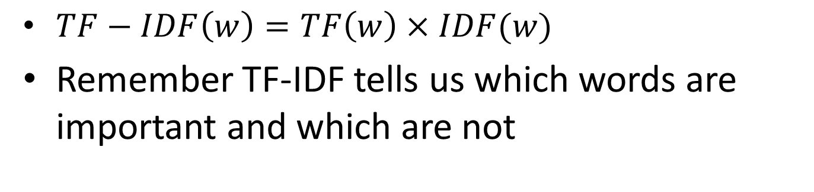
TF-IDF
$TF−IDF\left(w\right)=TF\left(w\right)×IDF(w)$
Remember TF-IDF tells us which words are important and which are not

Slide 33
Exploratory analysis of a corpus of text
Frequency: count number of times each word appears in the corpus
Conditional frequencies: count number of times each word appears in the Corpus dependent on an additional criteria
Concordance: a list showing all the appearances of a word or phrase
Similar: returns words in a range of contexts similar to that of the input word
Collocations: sequences of words that usually appear together

Slide 34
Gather text
Data cleaning
Represent text as data
Modeling Phase
Validation Phase
After all this text pre-processing, we now have an structured data set, so we can use traditional machine learning algorithms
We will use Naïve Bayes
Simple, yet well performing, specially in document classification
Allows every feature (word) in a document to contribute to its classification
Low false positive rate
Its main drawback is that it assumes independence between features (words). This assumption does not hold in real life
The Naive Bayes algorithm will calculate the conditional probability that an email is spam, conditioned on the text of the email.
Using our bag-of-words representation, we evaluate the probability of each word separately and sum them up.

Slide 35
Can we tell whether an email is spam or not?
Both humans and Naïve Bayes are assessing the probability the email is through
The key difference is that naïve base use frequency of words present in the email and historical examples of spam to assign a probability that the email in question is spam

Slide 36
Predicting whether an email is spam is an example of a classification task
We train our model by assessing how each word of the email contributes to a classification of spam or not spam, over our entire labeled sample of emails
Notice how our data frame is a bag of words count.
We did unigram tokenization to transform unstructured data to structured data

Slide 37
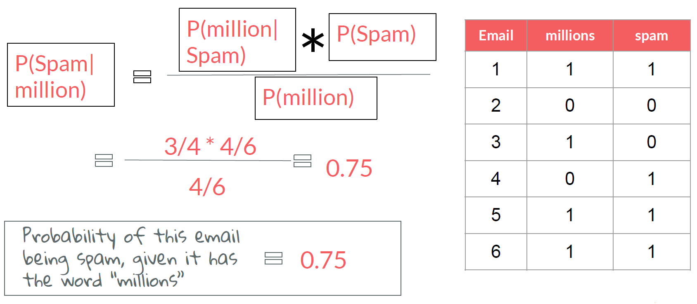
Probability of spam email given that email contains the word million

Slide 38
We should use all the words in the email

